Slide 1
General Knowledge
1
Where does Boxing Day get its name from?
2
Which is colder, the North or South Pole?
3
Name as many of Santa’s reindeer as you can – 1 point per name
4
On what day are ‘maids a-milking’ mentioned in the song '12 days of Christmas'?
5
What year was the first commercial Christmas card sold in the UK?
6
Who wrote the classic story “A Christmas Carol”?

Slide 2
True or False
1
In 2013 a law was past making it illegal to take misletoe into the house of commons, due to the risk it is seen as sexual harassment
2
The film White Christmas used asbestos to create the snow
3
Xmas pudding used to be a soup-like porridge
4
Mistletoe is an ancient symbol of fertility and virility (aphrodisiac)
5
During WWII a US card company created packs of cards for Xmas, that when wet revealed escape routes
6
Christmas trees are poisonous
7
The Christmas cracker was originally invented to sell bon-bon sweets

Slide 3
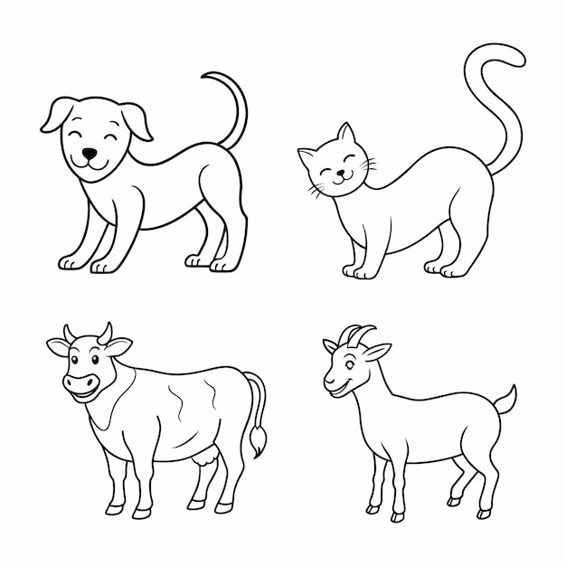
Creatures & Myths
1
The Yule Cat
2
The Yule Goat
In which country are you in danger of being devoured by the Yule Cat at Christmas?
In which country does the invisible spirit Yule Goat appear before Christmas to make sure holiday preparations were done correctly?

Slide 4
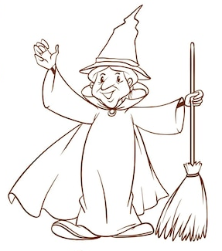
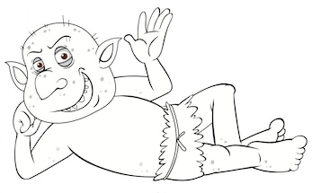
Creatures & Myths
3
Befana
4
Lutins
In which country would you find the Befana (a witch-like old woman) delivering gifts to children on Epiphany Eve (the night of January 5)
In which country would you find these festive hobgoblins?

Slide 5
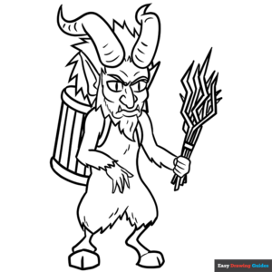
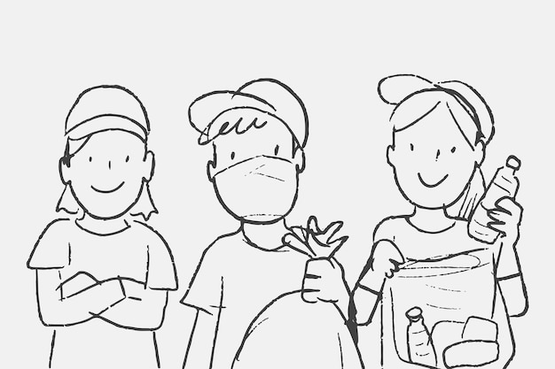
Creatures & Myths
5
Krampus
6
Yule Lads
In which country does Santa’s evil counterpart Krampus punish the naughty children, whilst Santa leaves gifts for the good ones?
In which country would you find the pranksters the Yule Lads?

Slide 6


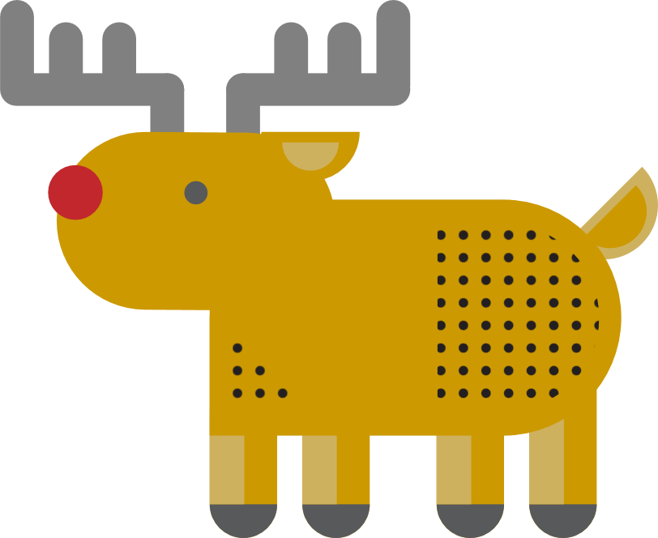



Around the World
1
2
Who is the largest exporter of Christmas trees?
Who has the most reindeer?
3
4
5
Who gifts a Christmas tree to Britain, placed in Trafalgar Square, for our help during WW11?
Extra point: since which year?
What is the largest Christmas present in world?
Where is the oldest Christmas Market in Europe

Slide 7
Music
1
What was the xmas number 1 in the year 2000?
2
What was the first song played in outer space?
Extra point: which year?
3
True or false: Irving Berlin hated Elvis Presley’s version of “White Christmas” so much he tried to prevent radio stations from playing it
4
From 1st to 3rd, who earns the most royalties from their Christmas sings?
Which song had a UK Christmas Singles Chart Number One twice, once in 1975 and again in 1991 (not “Do They Know It’s Christmas”)?
5

Slide 8
Food & Drink
1
In the middle ages, it was tradition for everyone to eat what Christmas treat for each of the 12 days of xmas - bringing good luck for the new year
2
Which is largest, the UK record for biggest Parsnip, Potato or Sprout?
3
Which fruit is traditionally put in a Christmas stocking?
4
In which country is it now traditional to eat KFC for Christmas dinner?
5
Which alcohol is traditionally added to the base of a trifle?
6
What type of pudding is asked for in the popular Christmas carol “We wish you a merry Christmas”?
7
What ingredient is traditionally layered under the icing of a Christmas cake?
8
What is the traditional Christmas drink made from eggs, milk and nutmeg?

Slide 9
Films
1
In Elf, Buddy the Elf anmes the 4 main food groups of his diet – candy, candy canes, candy corns and … what is the fourth?
2
What is the name of the Pumpkin King who discovers Christmas Town, in the film "The Nightmare Before Christmas" ?
3
Which 1994 Christmas movie features a young boy who receives a magical ticket to the North Pole on Christmas Eve?
4
In the classic film "It's a Wonderful Life," what is the name of the town where George Bailey lives?
5
In "Home Alone," what are the names of the two burglars trying to break into Kevin McCallister's house? 1 point each

